Slide 1
Changing Food Habits (Data Analysis based on COVID-19)
By Neha Sheth

Slide 2
Indoor Food Habits
Analysis of Indoor Food Habits can be sub categorized as follows –
-Dietary Components consumed in 5 countries, namely India, USA, UK, China and Russia, Detailed analysis of other countries can also be availed.
-Grocery Sales of USA, rising through the years, suddenly falling due to COVID 19 in 2020, and forecast on sales from 2020 to 2025
-Food and Beverage Sales of USA through the years, stark drop in 2020 and forecast for coming years
-Food Expenditure per person in different countries in the year 2016
-Detailed Food Expenditure per person in India and forecast for the future years

Slide 3
Outdoor Food Habits
Analysis of Outdoor Food Habits can be sub categorized as follows –
-Sales of Fast Food Joints in USA from 2017 to 2019
-Number of Units of Fast Food joints in USA from 2017 to 2019.
-Revenue of Food Services and Drinking Places in USA through the years, suddenly falling due to COVID 19 in 2020, and forecast on revenue from 2020 to 2025.
-Revenue of Retail Trade and Food Services of USA through these years and forecast for the future.

Slide 4
Dietary Commodities
Belgium, Austria, Canada, USA and Italy consume the most amount of Oils and Fats in their diets.
USA, Trinidad and Tobago, Cuba, Columbia and New Zealand consume most amount of Sugars.
Ethiopia, Burkina Faso, Chad, Zimbabwe and Mongolia consume least Fruits and Vegetables.
Egypt, Lesotho, Morocco, Bangladesh and Mali consume most amount of Cereals and Grains.
Among USA, UK, Russia, China and India, we can observe low vegetable and fruit intake in India and excess Oil and Fat intake in USA.

Slide 5
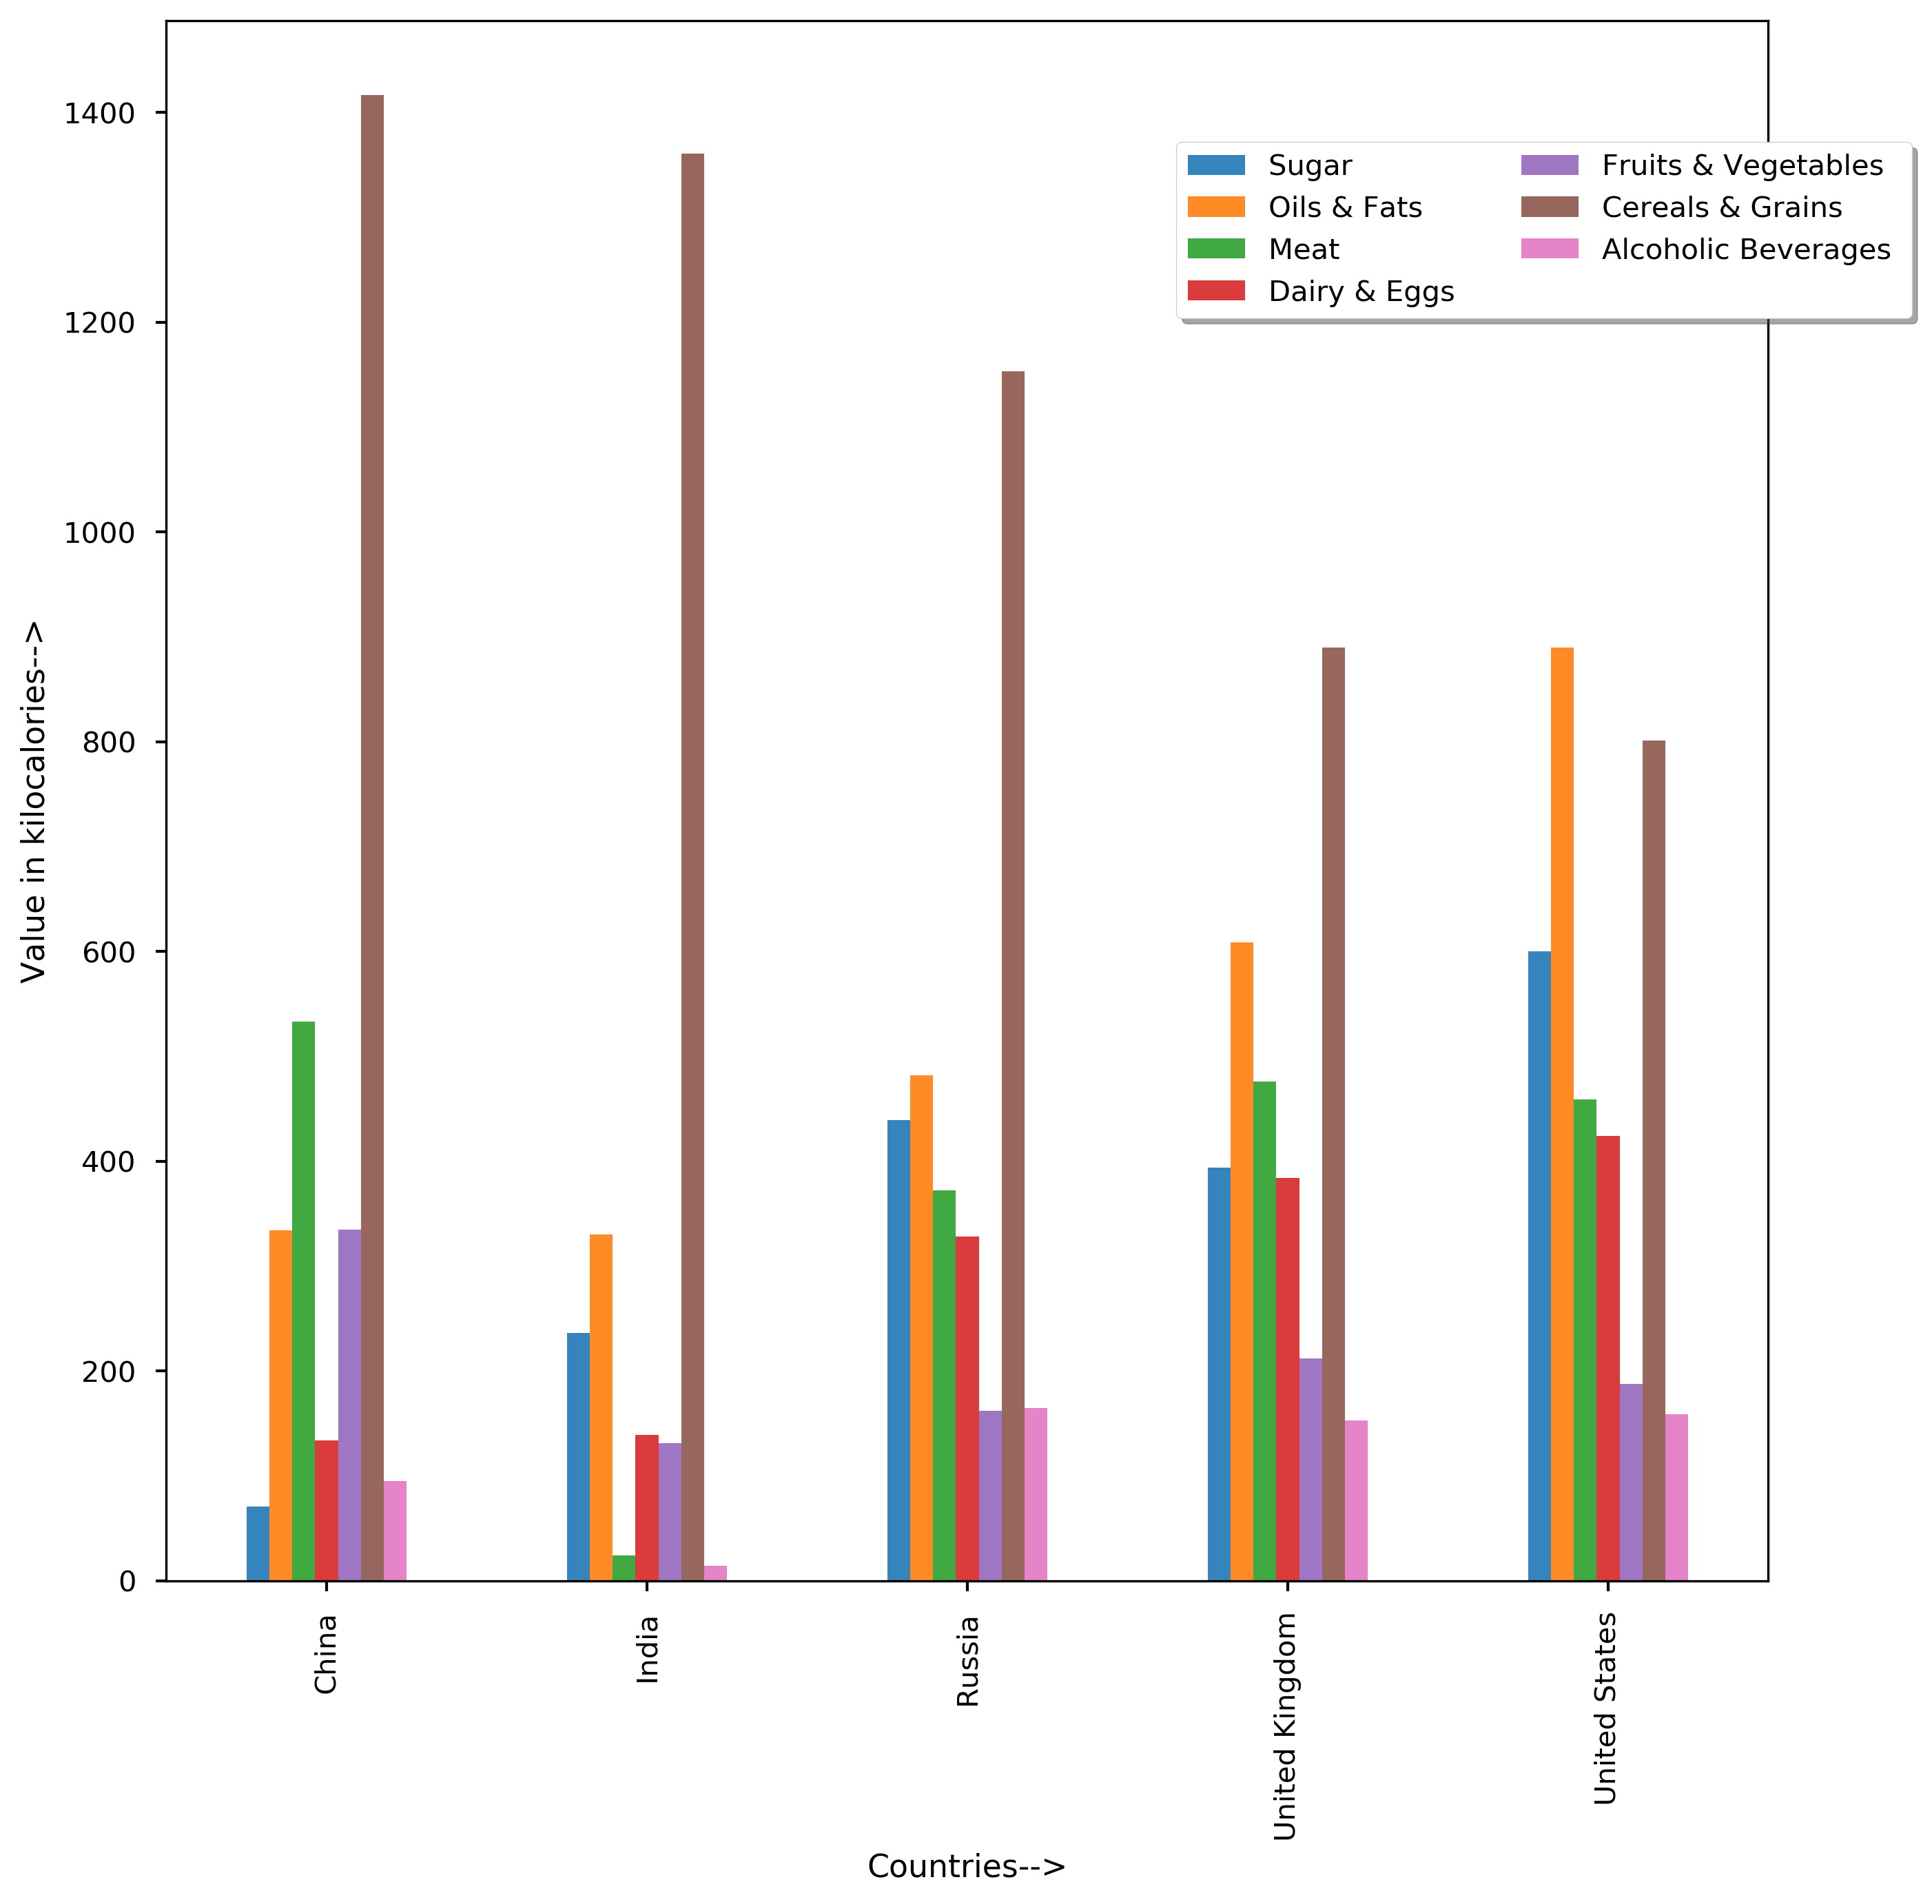

Slide 6
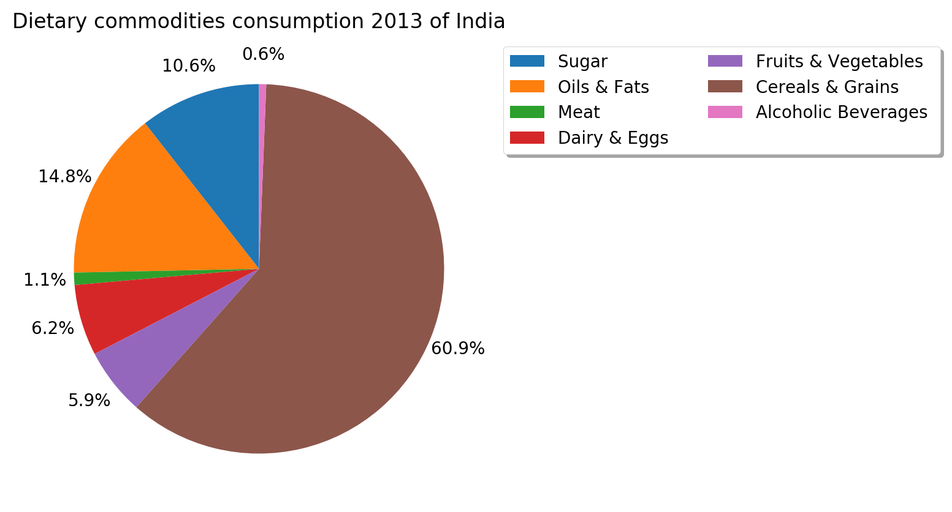
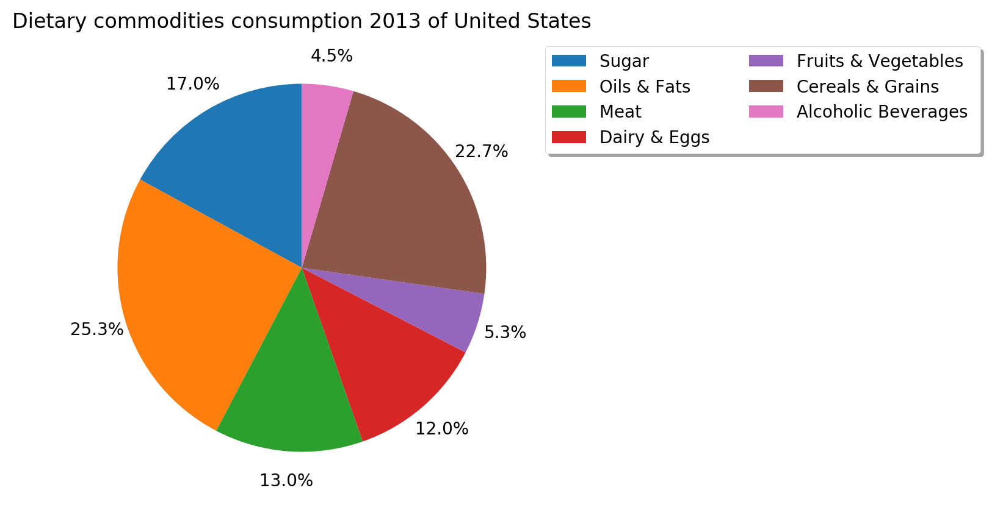

Slide 7
Forecast of Food, Beverage and Grocery Sales
Long term impacts of COVID 19 :
Permanent shift to online grocery shopping.
Sustained changes in shopping categories – People paying more attention to health and hygiene product shopping
Tax impacts – Taxes on products could increase to compensate for losses incurred, causing lower grocery shopping budgets among people.
Local shopping – People will tend to shop locally, make food at home to save money and support local businesses.

Slide 8
Food, Beverage and Grocery Sales of USA
-Sales exponentially increasing from 2016.
-Peak of sales in March 2020, with sales of $73718, highest till date.
-After reaching peak, grocery sales fall abruptly due to COVID-19, from highest to $63958 in April 2020. This has also fallen further in May.
Note : this is seasonally adjusted data obtained from United States Census Bureau’s official website.

Slide 9
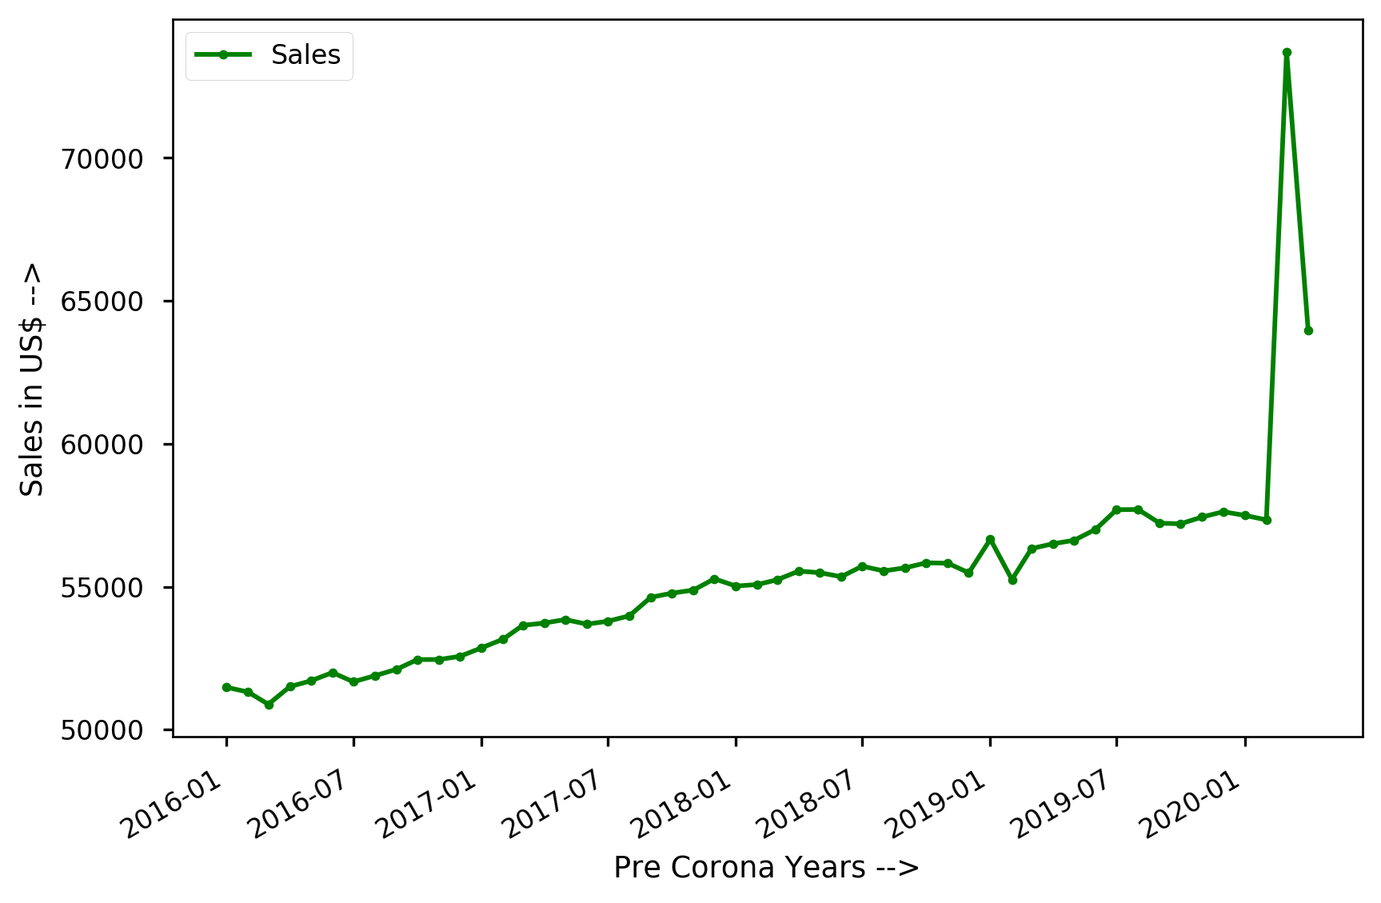

Slide 10
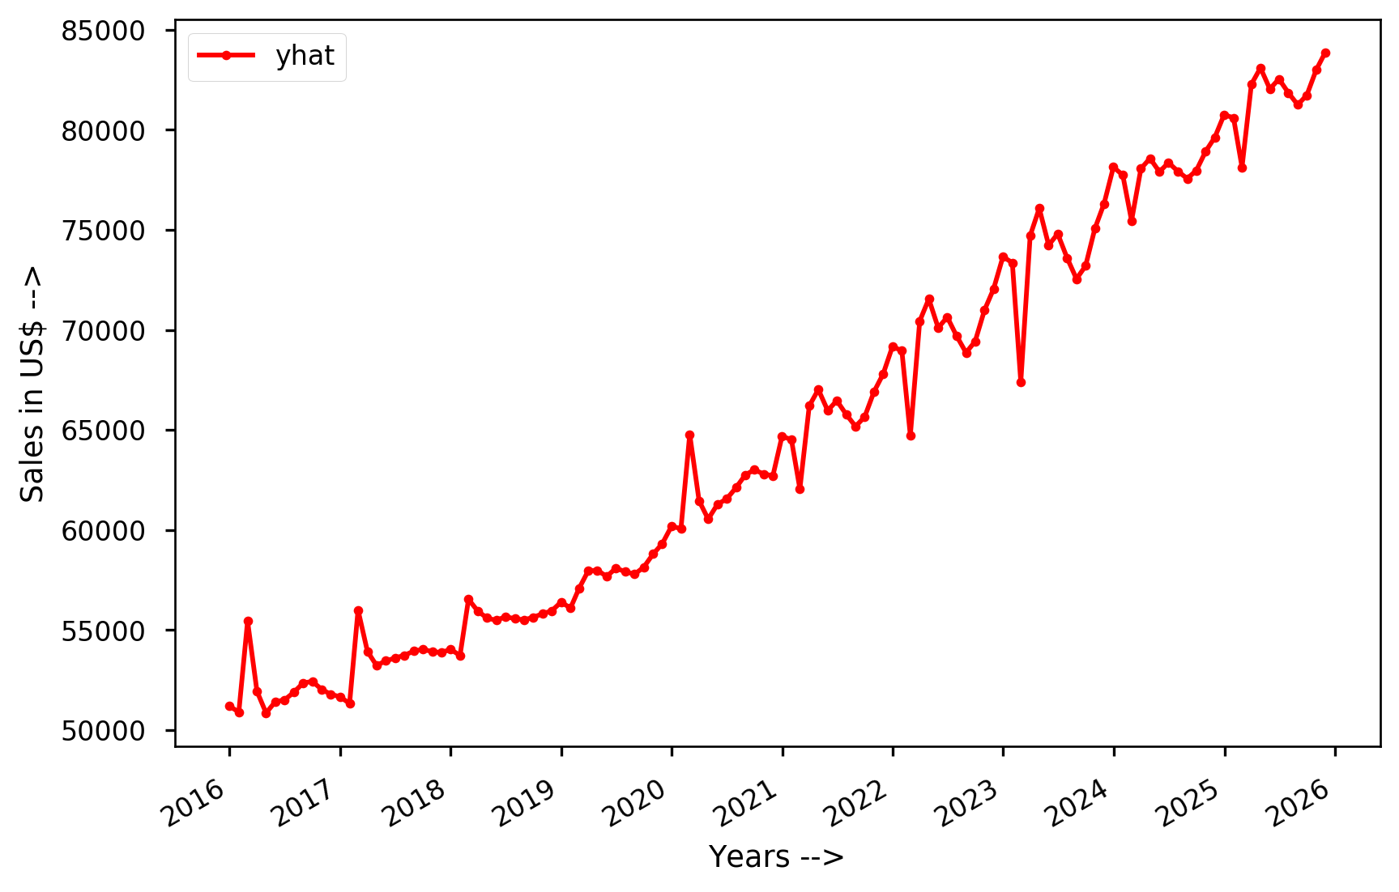
Forecast of Grocery Sales

Slide 11
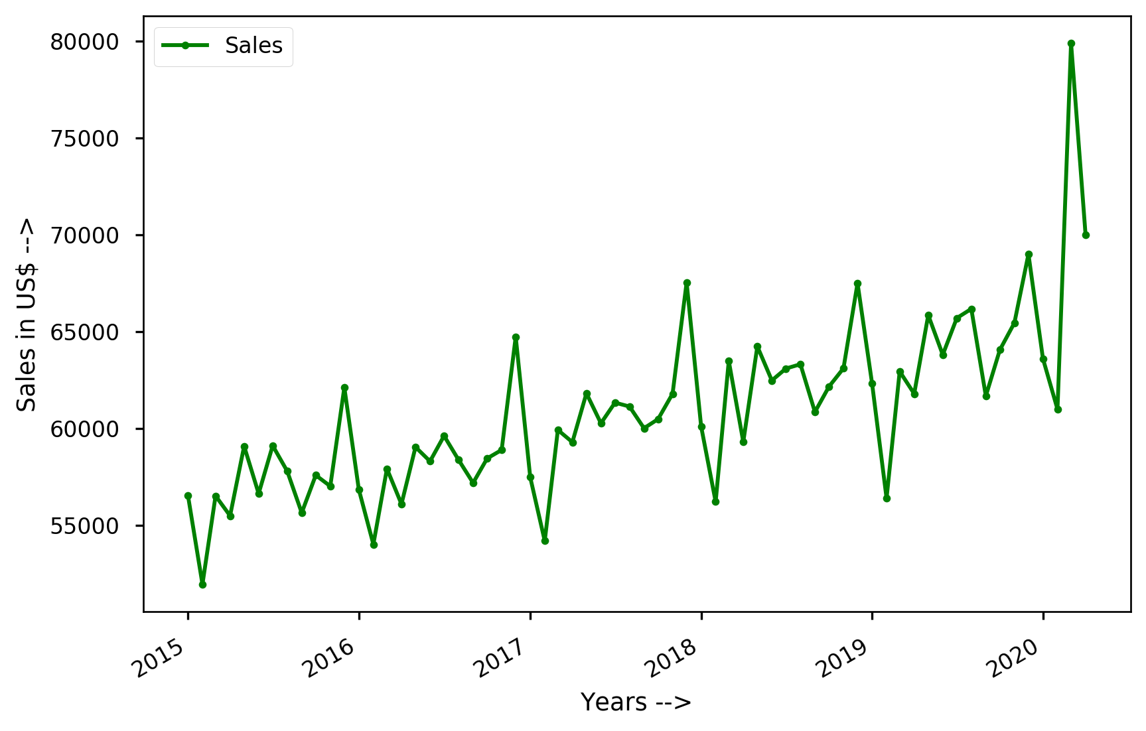
Food and Beverage Sales of USA

Slide 12
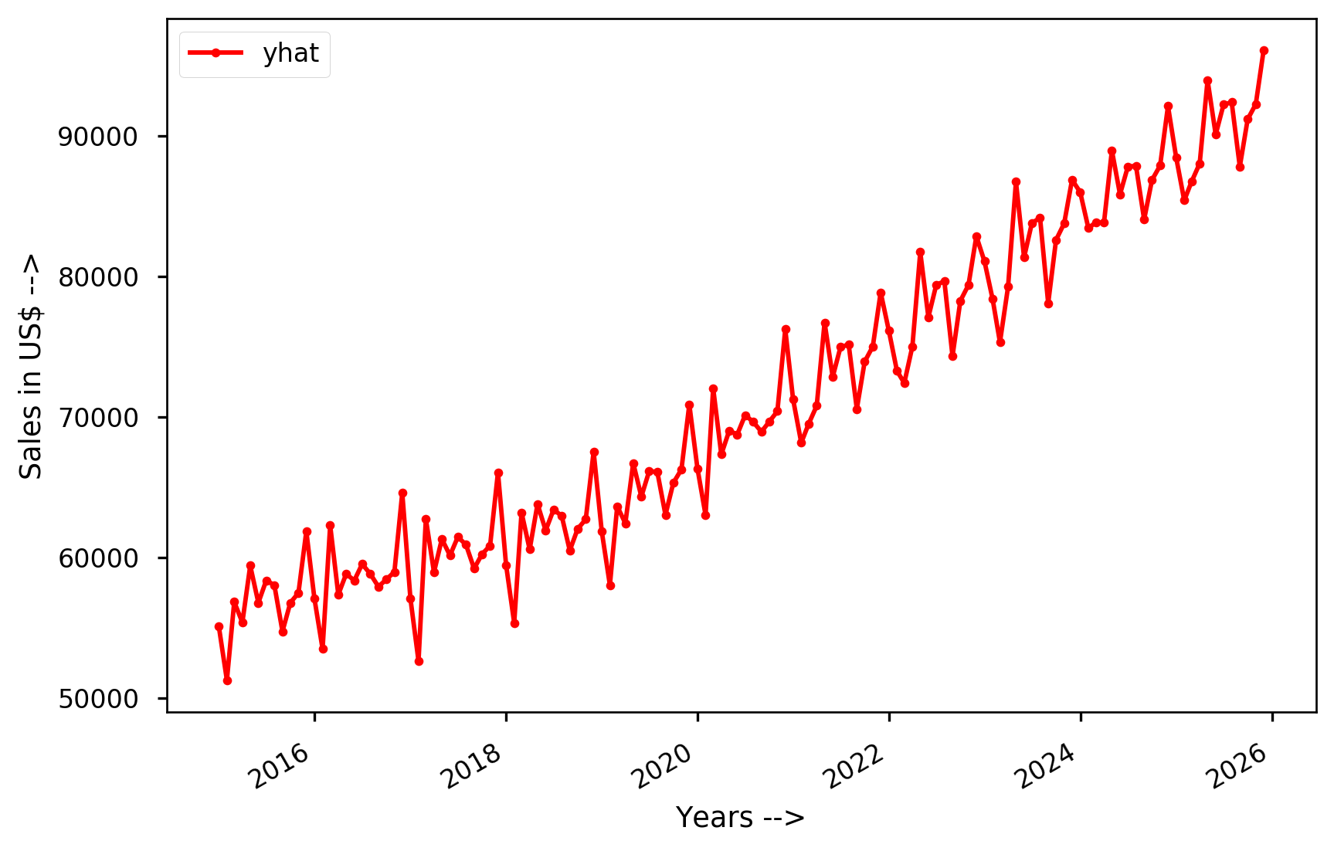
Forecast of Food and Beverage Sales of USA
Despite COVID-19, there will be a peak in sales in 2021 when life starts going back to normal.

Slide 13
Food Expenditure
-Highest per person food expenditure observed in Hong Kong, Switzerland, Norway, Israel and New Zealand.
-Among USA, UK, India, Russia and China, India has lowest food expenditure followed by China.

Slide 14
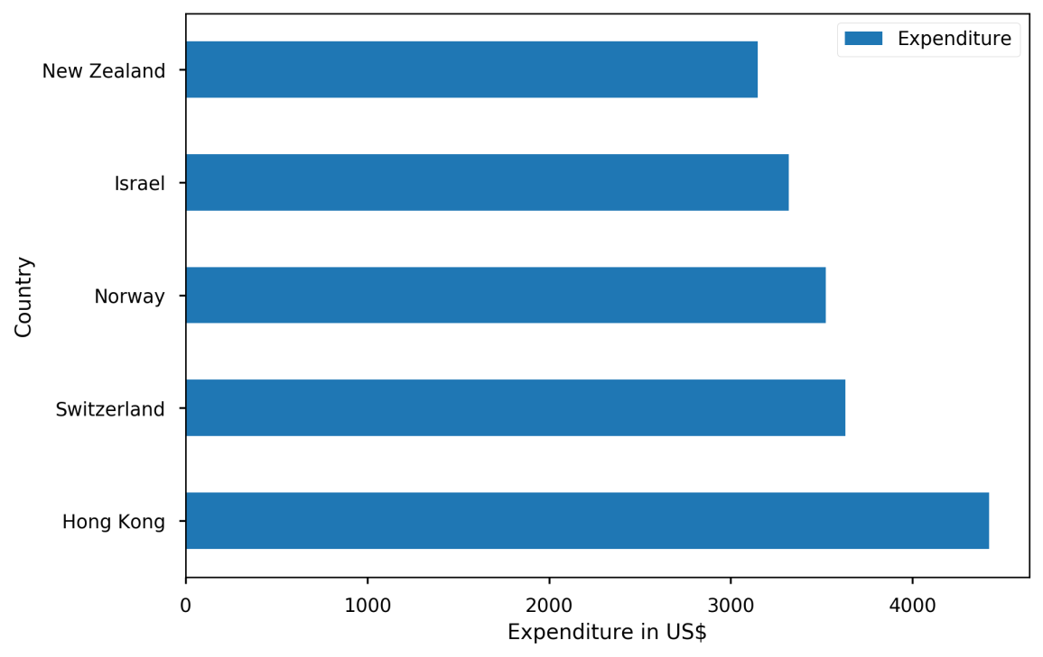
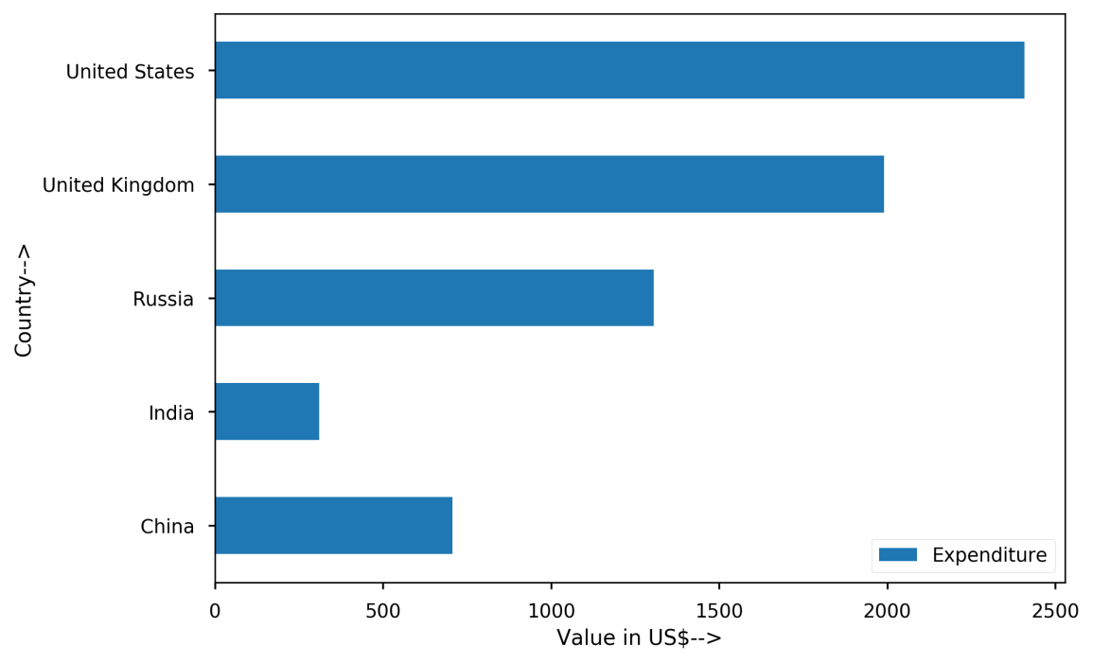
Countries with highest per person food expenditure
India has very low food expenditure as of 2016.

Slide 15
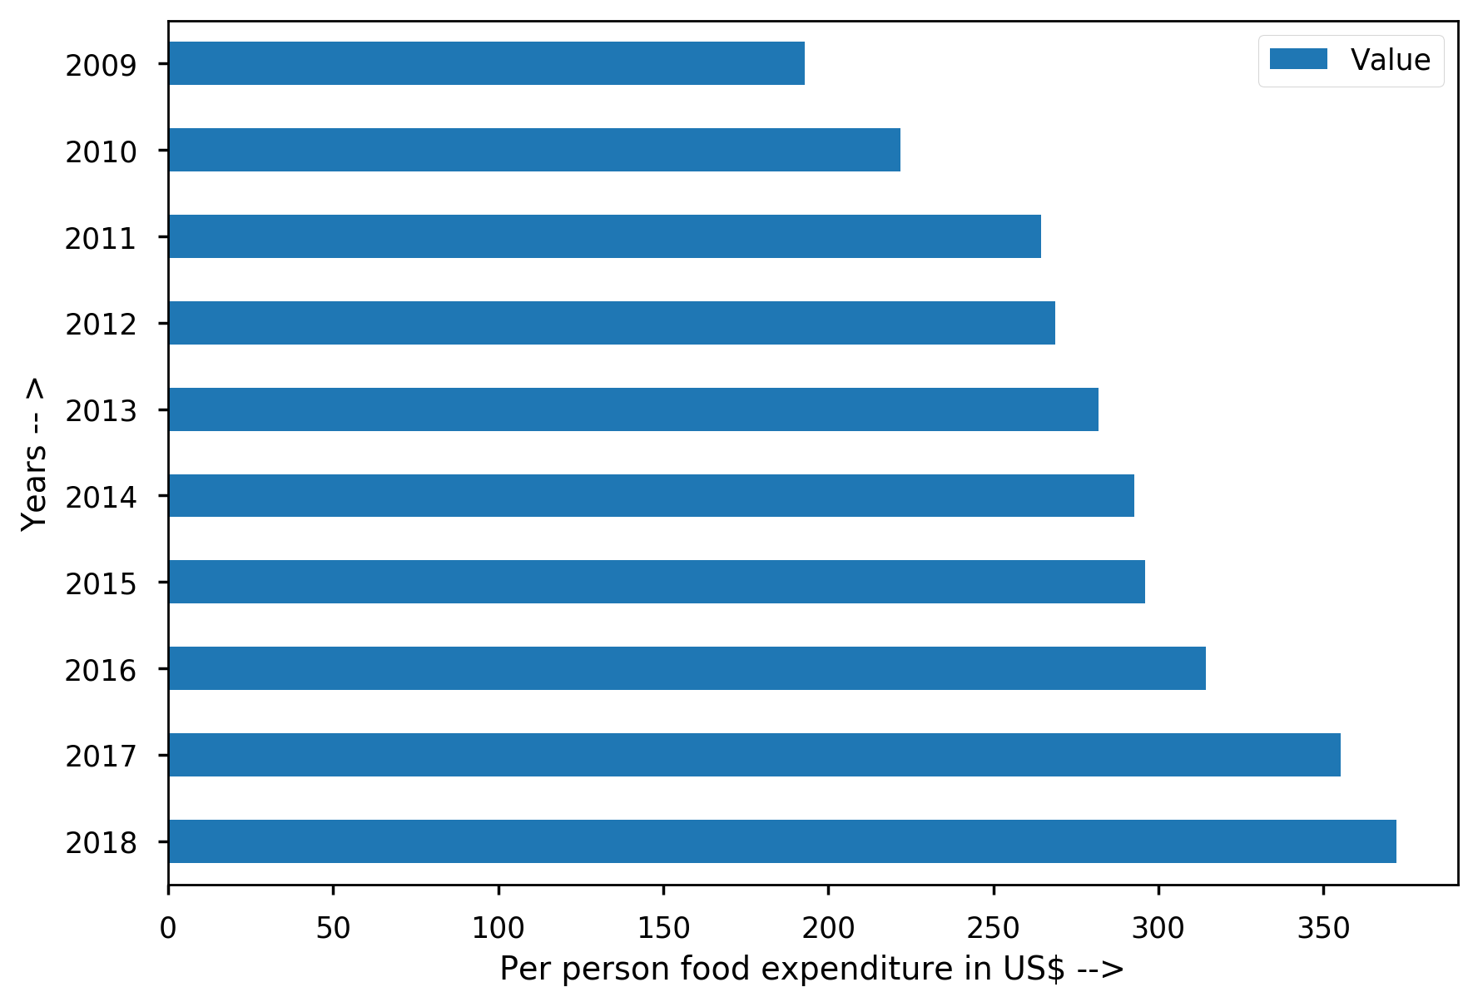
India’s Food Expenditure
It has been rising through the years.

Slide 16
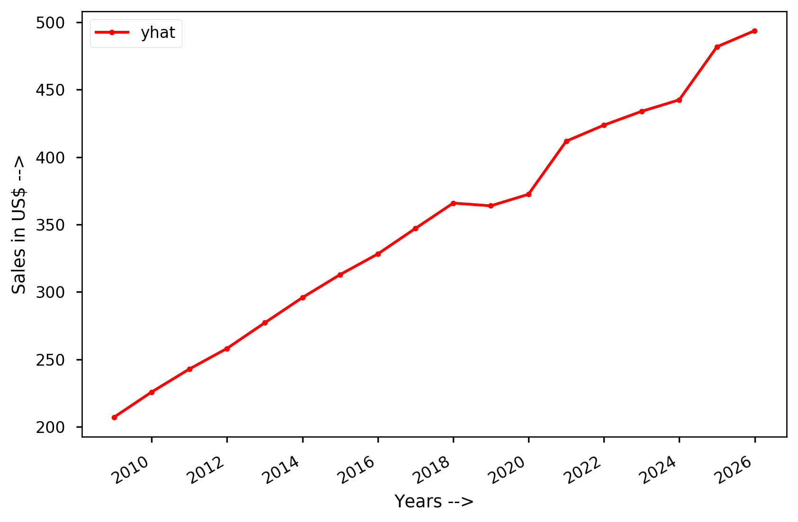
Forecast after COVID-19
Despite the decrease in food expenditures in 2020, it will still continue to rise in the future,

Slide 17
Fast Food Joints of USA
-Mc Donald’s found to have highest sales in all years, with peak in 2019.
-Subway found to have highest number of units set up.

Slide 18
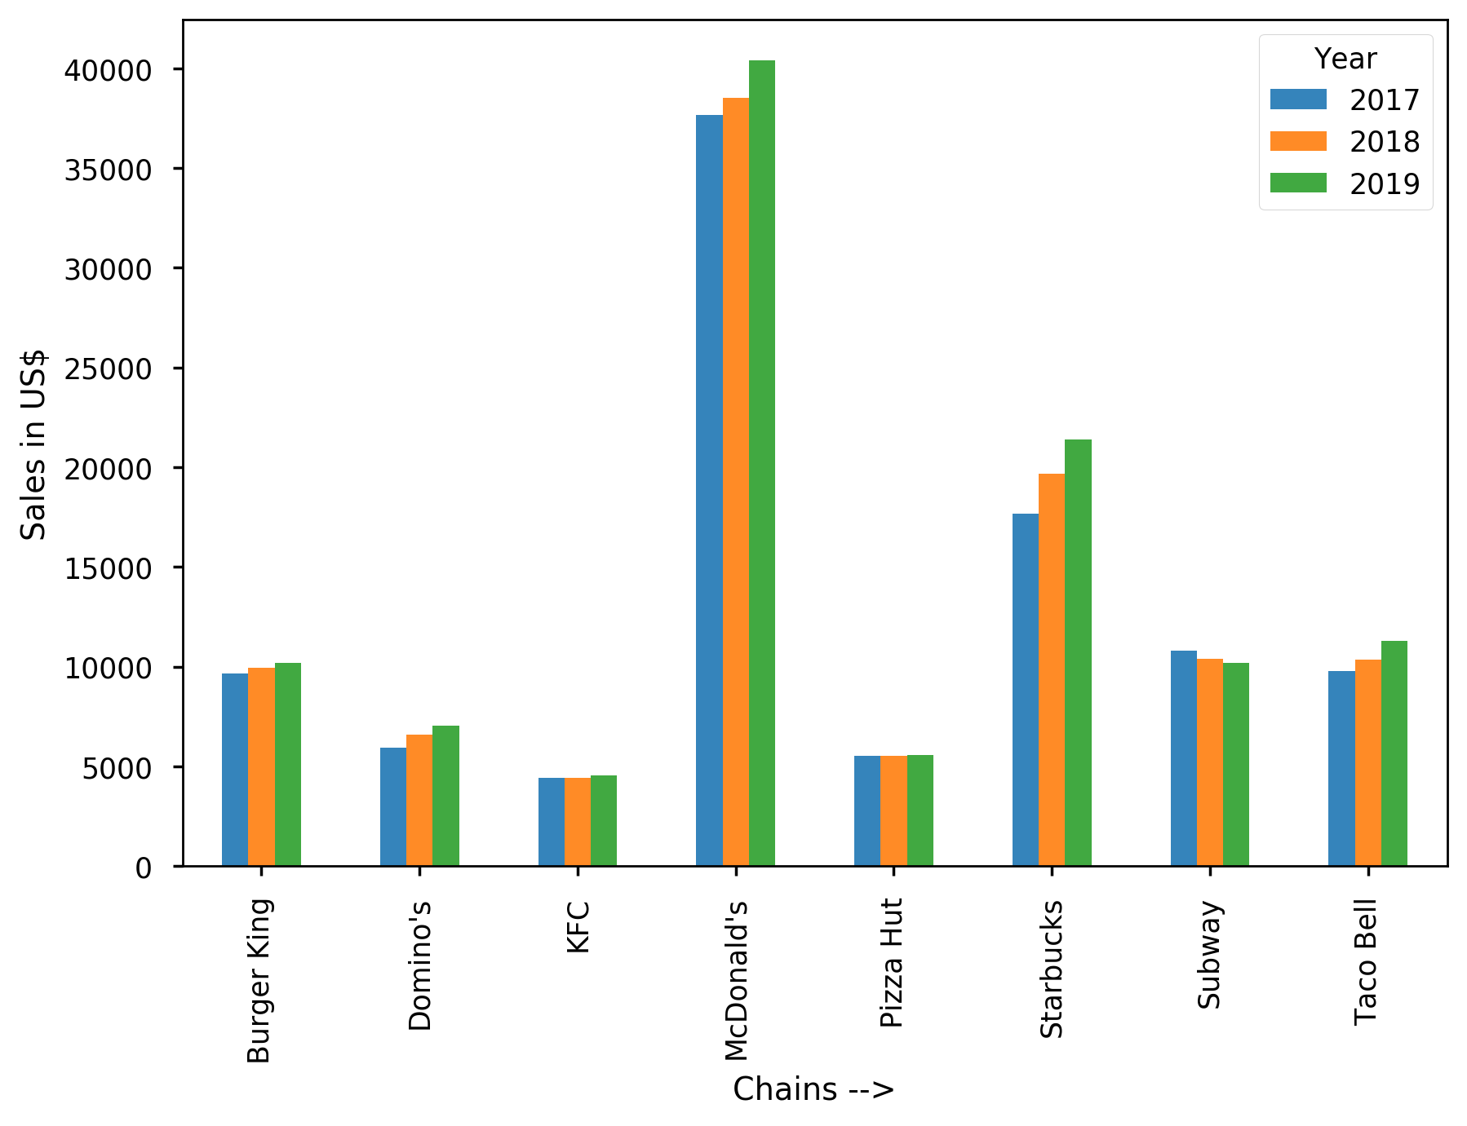
SALES IN USA

Slide 19
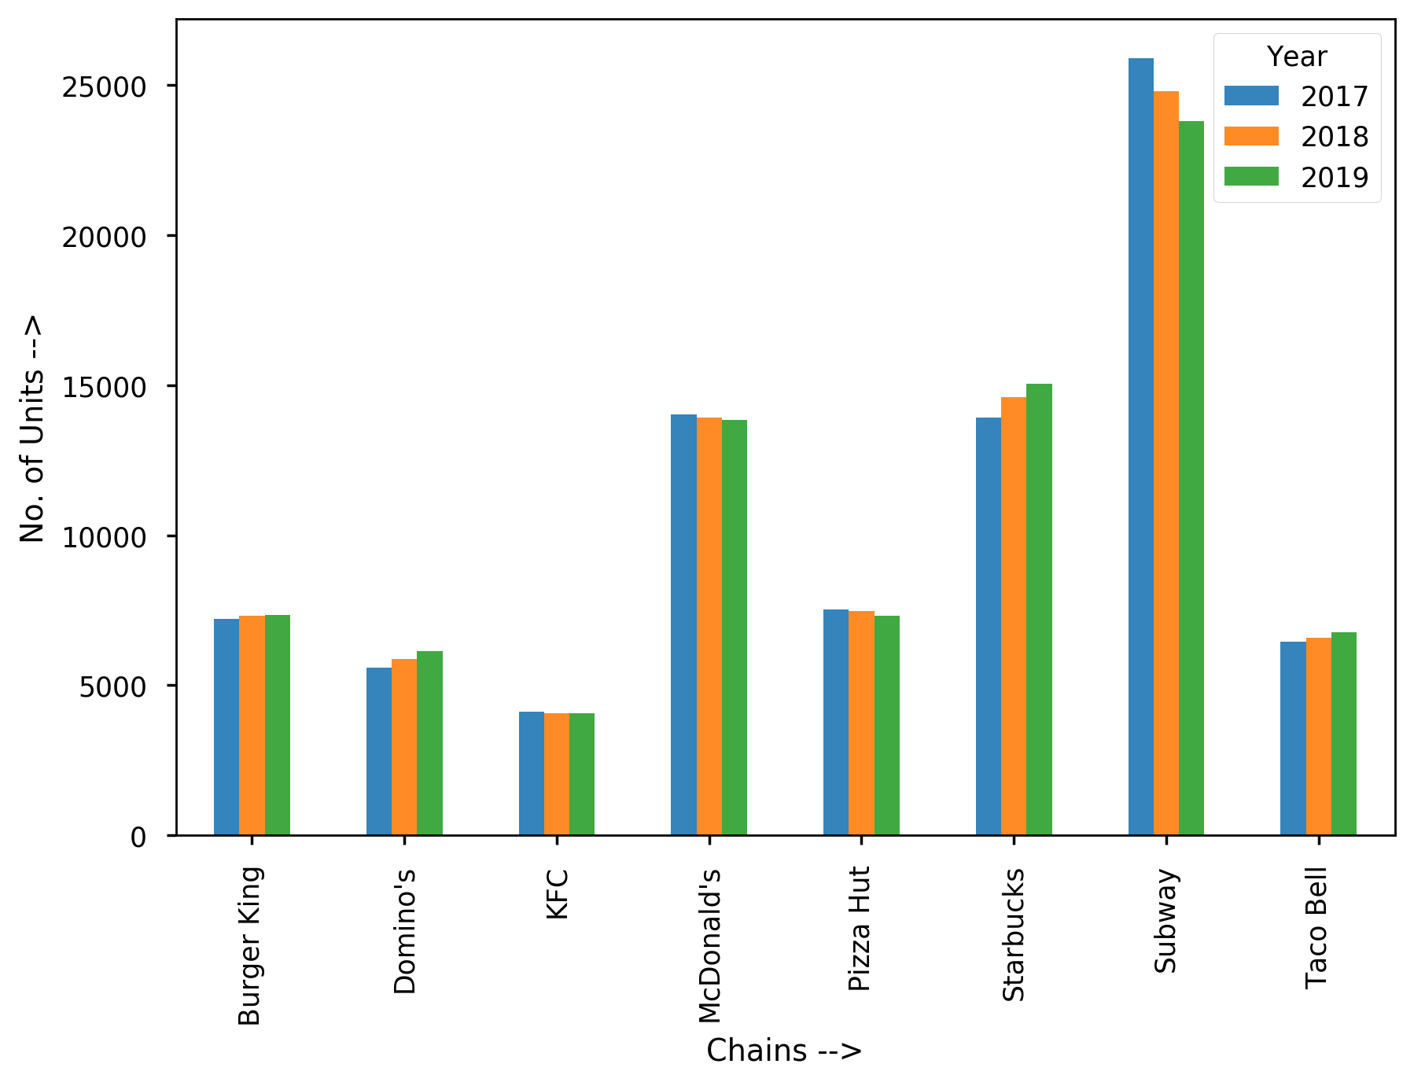
No. Of Units in USA

Slide 20
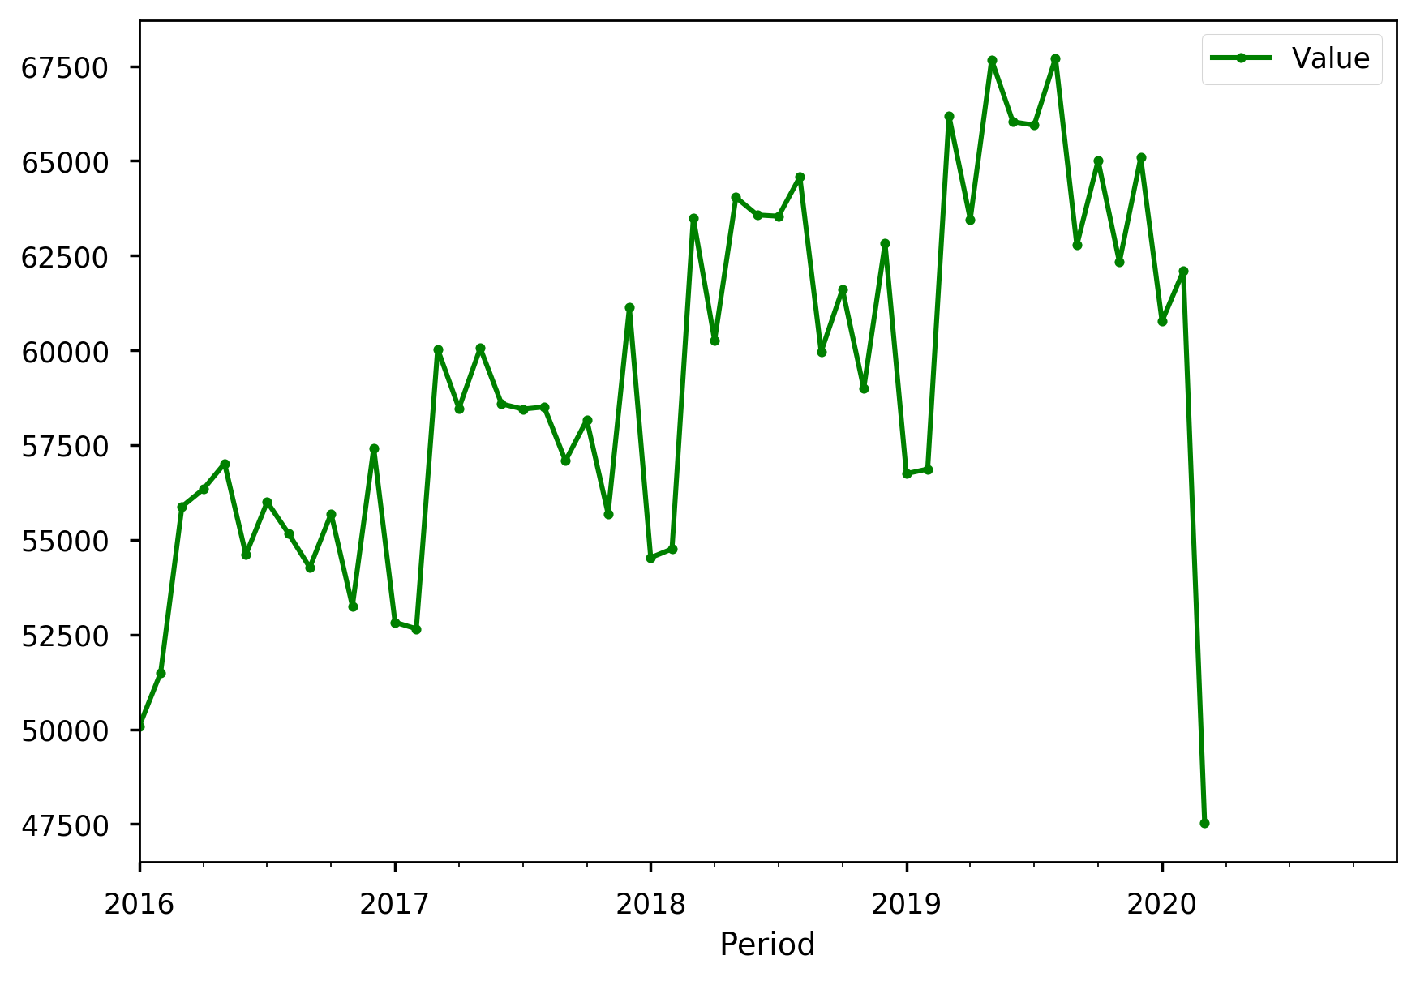
Food Services and Drinking Places USA
Food and Drinking Places are among affected the most due to COVID 19 in 2020.

Slide 21
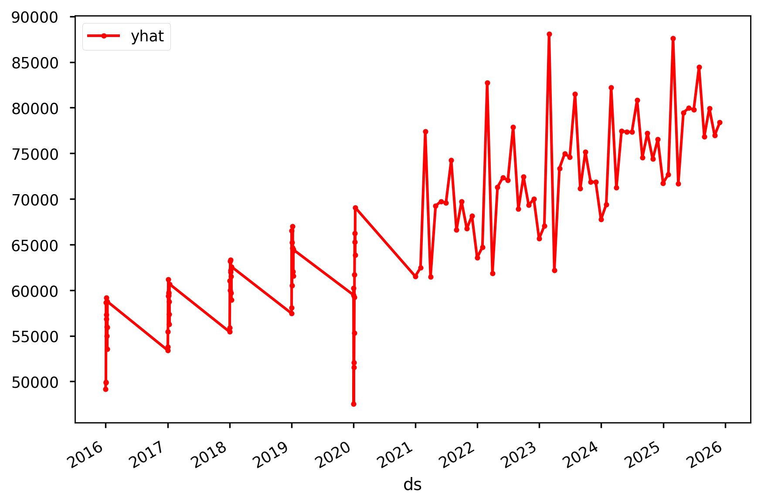
Forecast of Food and Drinking Places
They will steadily increase and then start rising after 2021.

Slide 22
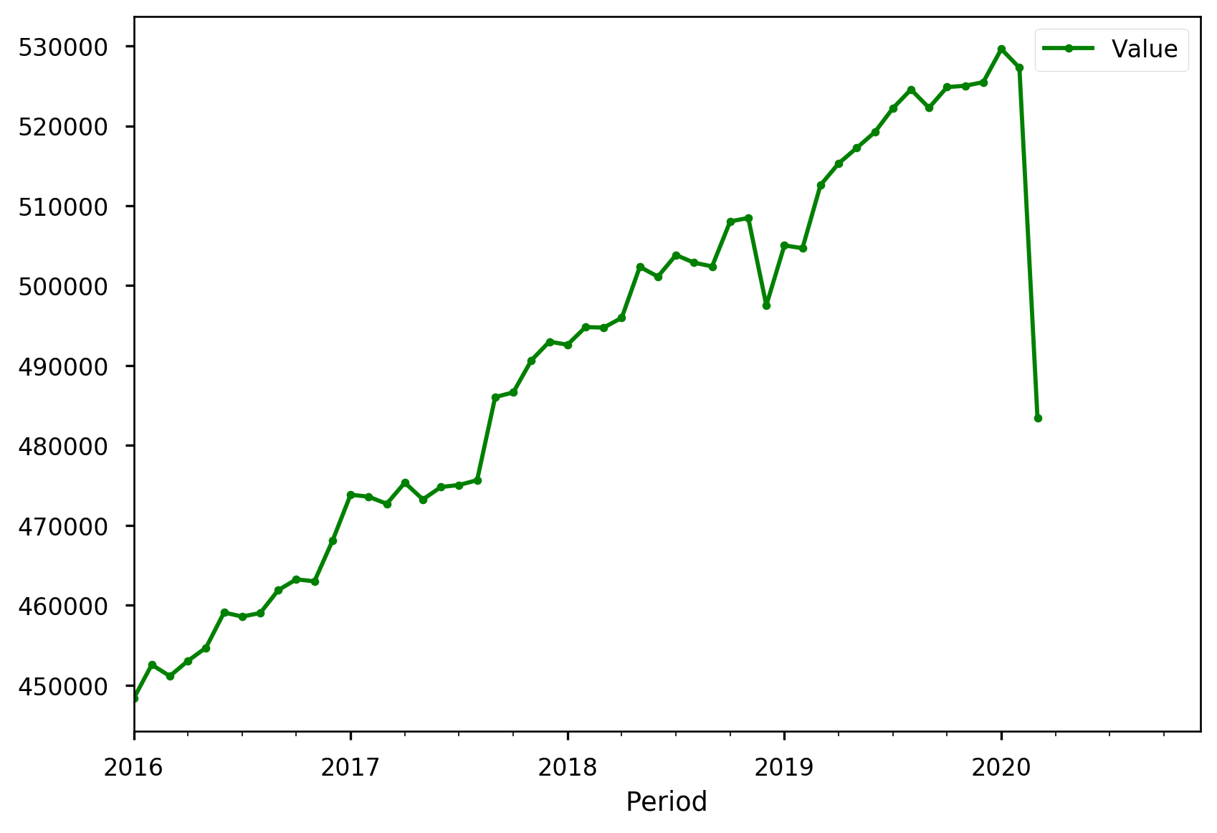
Food and Retail Services USA
Sudden drop in food retail sales and revenue due to COVID 19 in 2020.

Slide 23
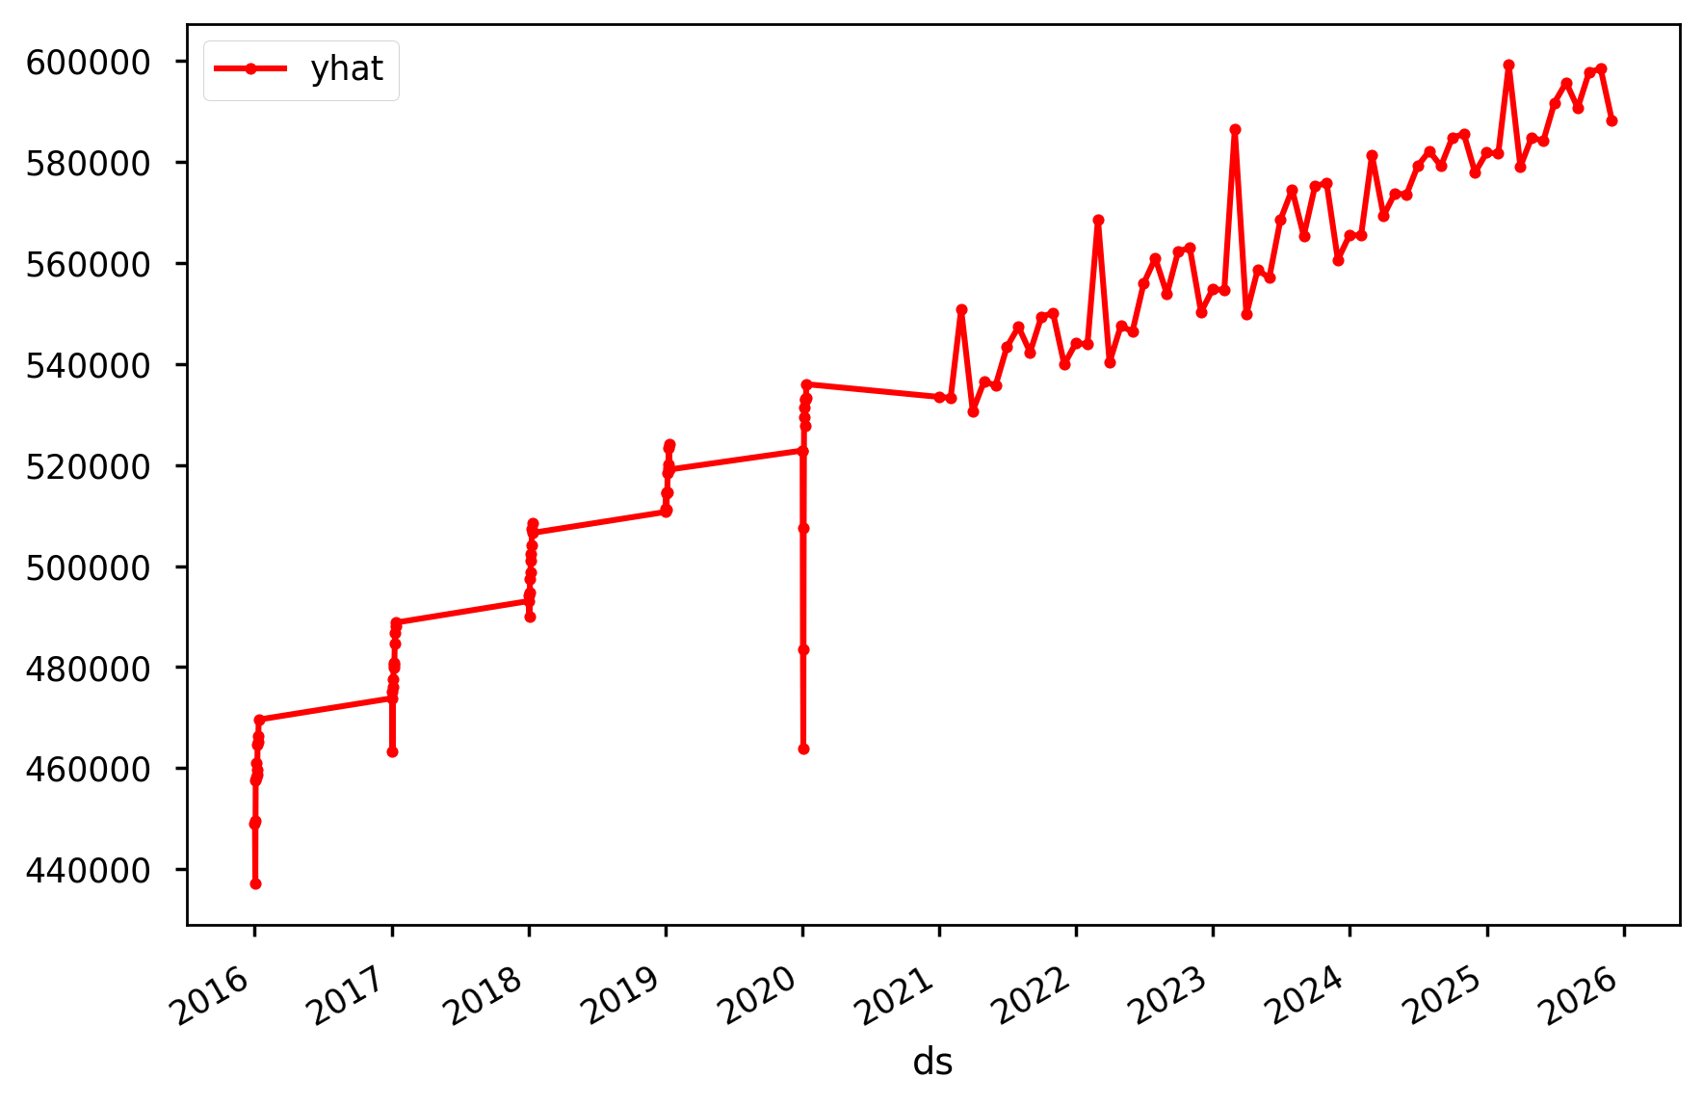
Forecast of Food and Retail
Despite drop due to COVID-19 in 2020, the future years will see immense growth in Food Retail.

Slide 24
Evolving Eating Habits of People
-As a result of COVID-19, consumers are becoming more concerned about the environment and are seeking out moments of comfort, both of which will shape eating habits.
-COVID-19 is amplifying the risk of a worldwide food-price spike, which would trigger crises in many developing countries.

